Slide 1
Relational Algebra
Lecture # 3C
Imran Siddiqi
imran.siddiqi@mcs.edu.pk
Computer Science Department
College of Telecommunication Engineering
National University of Sciences and Technology

Slide 2
Contents
Example Queries using Relational Algebra
Database Modification
  Insert
  Delete
Views

Slide 3
Examples of Queries
Reserves
Sid | Bid | Day
22 | 101 | 10/10/98
22 | 102 | 10/10/98
22 | 103 | 10/8/98
22 | 104 | 10/7/98
31 | 102 | 11/10/98
31 | 103 | 11/6/98
31 | 104 | 11/12/98
64 | 101 | 9/5/98
64 | 102 | 9/8/98
74 | 103 | 9/8/98
Sailors
Sid | Sname | Rating | Age
22 | Dustin | 7 | 45.0
29 | Brutus | 1 | 33.0
31 | Lubber | 8 | 55.5
32 | Andy | 8 | 25.5
58 | Rusty | 10 | 35.0
64 | Horatio | 7 | 35.0
71 | Zorba | 10 | 16.0
74 | Horatio | 9 | 35.0
85 | Art | 3 | 25.5
95 | Bob | 3 | 63.5
Example instances of relations used
Boats
Bid | Bname | Color
101 | Interlake | Blue
102 | Interlake | Red
103 | Clipper | Green
104 | Marine | Red

Slide 4
Example Queries
Sailors
Sid | Sname | Rating | Age
22 | Dustin | 7 | 45.0
29 | Brutus | 1 | 33.0
31 | Lubber | 8 | 55.5
32 | Andy | 8 | 25.5
58 | Rusty | 10 | 35.0
64 | Horatio | 7 | 35.0
71 | Zorba | 10 | 16.0
74 | Horatio | 9 | 35.0
85 | Art | 3 | 25.5
95 | Bob | 3 | 63.5
Reserves
Sid | Bid | Day
22 | 101 | 10/10/98
22 | 102 | 10/10/98
22 | 103 | 10/8/98
22 | 104 | 10/7/98
31 | 102 | 11/10/98
31 | 103 | 11/6/98
31 | 104 | 11/12/98
64 | 101 | 9/5/98
64 | 102 | 9/8/98
74 | 103 | 9/8/98
Sid | Bid | Day
22 | 103 | 10/8/98
31 | 103 | 11/6/98
74 | 103 | 9/8/98
Sid | SName | Rating | Age | Bid | Day
22 | Dustin | 7 | 45.0 | 103 | 10/8/98
31 | Lubber | 8 | 55.5 | 103 | 11/6/98
74 | Horatio | 9 | 35.0 | 103 | 9/8/98
Find the names of sailors who have reserved boat 103

Slide 5
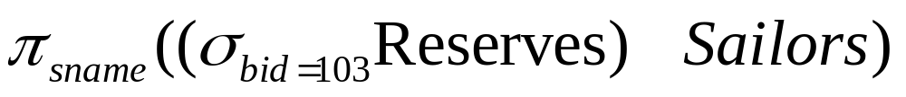
Example Queries
Find the names of sailors who have reserved boat 103
Sid | SName | Rating | Age | Bid | Day
22 | Dustin | 7 | 45.0 | 103 | 10/8/98
31 | Lubber | 8 | 55.5 | 103 | 11/6/98
74 | Horatio | 9 | 35.0 | 103 | 9/8/98

Slide 6
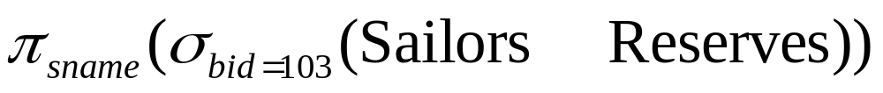
Example Queries
Find the names of sailors who have reserved boat 103
What if we write the Query as follows:

Slide 7
Reserves
Sailors
Sid | Bid | Day
22 | 101 | 10/10/98
22 | 102 | 10/10/98
22 | 103 | 10/8/98
22 | 104 | 10/7/98
31 | 102 | 11/10/98
31 | 103 | 11/6/98
31 | 104 | 11/12/98
64 | 101 | 9/5/98
64 | 102 | 9/8/98
74 | 103 | 9/8/98
Sid | Sname | Rating | Age
22 | Dustin | 7 | 45.0
29 | Brutus | 1 | 33.0
31 | Lubber | 8 | 55.5
32 | Andy | 8 | 25.5
58 | Rusty | 10 | 35.0
64 | Horatio | 7 | 35.0
71 | Zorba | 10 | 16.0
74 | Horatio | 9 | 35.0
85 | Art | 3 | 25.5
95 | Bob | 3 | 63.5
10/8/98
9/8/98
Day
11/6/98
Bid
103
103
103
Age
45.0
55.5
35.0
Rating
7
8
9
Sid | SName | Rating | Age | Bid | Day
22 | Dustin | 7 | 45.0 | 101 | 10/10/98
22 | Dustin | 7 | 45.0 | 102 | 10/10/98
22 | Dustin | 7 | 45.0 | 103 | 10/8/98
22 | Dustin | 7 | 45.0 | 104 | 10/7/98
31 | Lubber | 8 | 55.5 | 102 | 11/10/98
31 | Lubber | 8 | 55.5 | 103 | 11/6/98
31 | Lubber | 8 | 55.5 | 104 | 11/12/98
64 | Horatio | 7 | 35.0 | 101 | 9/5/98
64 | Horatio | 7 | 35.0 | 102 | 9/8/98
74 | Horatio | 9 | 35.0 | 103 | 9/8/98
SName
Dustin
Lubber
Horatio
22
74
Sid
31

Slide 8
Example Queries
Sailors
Reserves
Sid | Sname | Rating | Age
22 | Dustin | 7 | 45.0
… | … | … | …
Sid | Bid | Day
22 | 101 | 10/10/98
… | … | …
Boats
Bid | Bname | Color
101 | Interlake | Blue
… | … | …
Find the names of sailors who have reserved a red boat

Slide 9
Example Queries
Sailors(Sid, Sname, Rating, Age)
Boats (Bid, Bname, Color)
Reserves (Sid, Bid, Day)
Find the colors of the boats reserved by Lubber

Slide 10
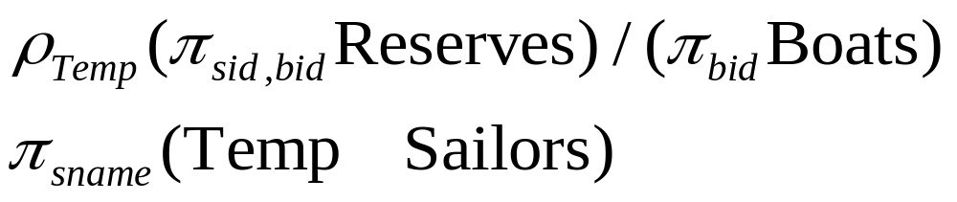
Example Queries
Sailors(Sid, Sname, Rating, Age)
Boats (Bid, Bname, Color)
Reserves (Sid, Bid, Day)
Find the names of the sailors who have reserved all the boats

Slide 11
Example Queries
Employee(person_name,street, city)
Works (person_name, company_name,salary)
Company (company_name, city)
Manages(person_name, ,manager_name)
Can we convert it back to ERD

Slide 12
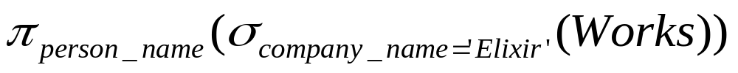
Example Queries
Employee(person_name,street, city)
Works (person_name, company_name,salary)
Company (company_name, city)
Manages(person_name, ,manager_name)
Find the names of all employees who work for Elixir

Slide 13
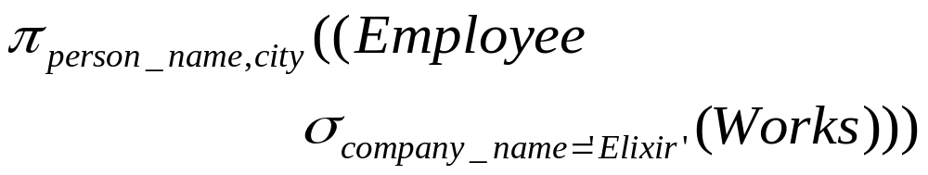
Example Queries
Employee(person_name,street, city)
Works (person_name, company_name,salary)
Company (company_name, city)
Manages(person_name, ,manager_name)
Find the names and cities of residence of all employees who work for ‘Elixir’.

Slide 14
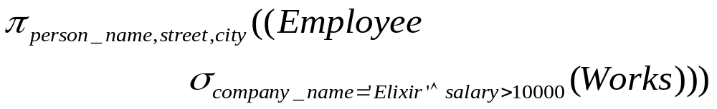
Example Queries
Employee(person_name,street, city)
Works (person_name, company_name,salary)
Company (company_name, city)
Manages(person_name, ,manager_name)
Find the names, street address, and cities of residence of all employees who work for ‘Elixir’ and earn more than $10,000 per annum

Slide 15
Example Queries
Employee(person_name,street, city)
Works (person_name, company_name,salary)
Company (company_name, city)
Manages(person_name, ,manager_name)
Find the names of all employees in this database who live in the same city as the company for which they work.

Slide 16
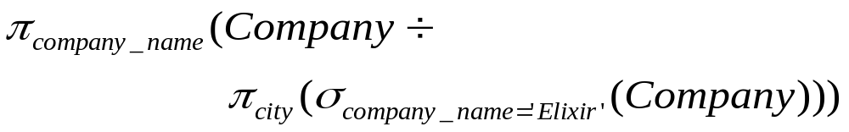
Example Queries
Employee(person_name,street, city)
Works (person_name, company_name,salary)
Company (company_name, city)
Manages(person_name, ,manager_name)
Assume the companies may be located in several cities. Find all companies located in every city in which ‘Elixir’ is located.

Slide 17
Modification of Database
Database Modification
  Delete
  Insert
  Update
All these operations are expressed using the assignment operator
We will discuss Delete & Insert
.

Slide 18
Deletion
A delete request is expressed similarly to a query, except instead of displaying tuples to the user, the selected tuples are removed from the database.
Can delete only whole tuples; cannot delete values on only particular attributes
A deletion is expressed in relational algebra by:
r ← r – E
where r is a relation and E is a relational algebra query.

Slide 19
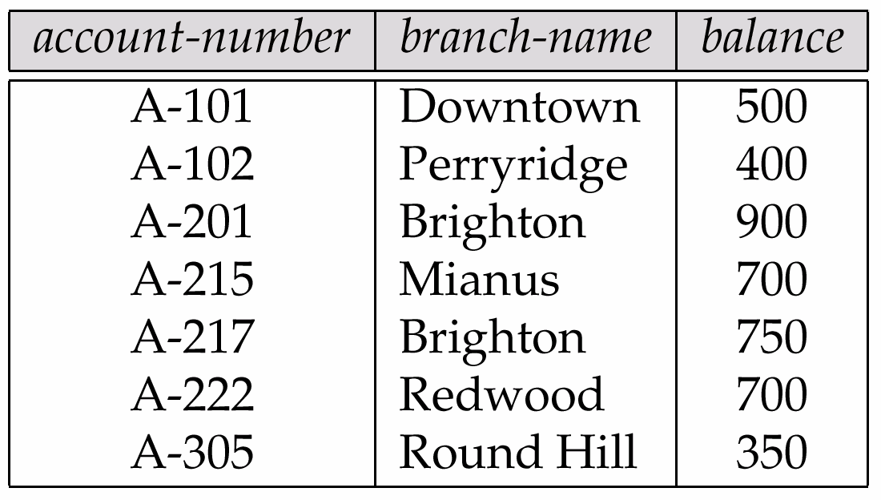
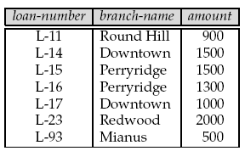
Deletion: Examples
Delete all account records in the Perryridge branch.
account ← account – σ _{branch-name = “Perryridge”} (account)
Delete all loan records with amount in the range of 0 to 50
loan ← loan – σ _{amount ≥ 0 and amount ≤ 50} (loan)

Slide 20
Insertion
To insert data into a relation, we either:
  Specify a tuple to be inserted
  Write a query whose result is a set of tuples to be inserted
In relational algebra, an insertion is expressed by:
r ← r ∪ E
where r is a relation and E is a relational algebra expression.
The insertion of a single tuple is expressed by letting E be a constant relation containing one tuple.

Slide 21
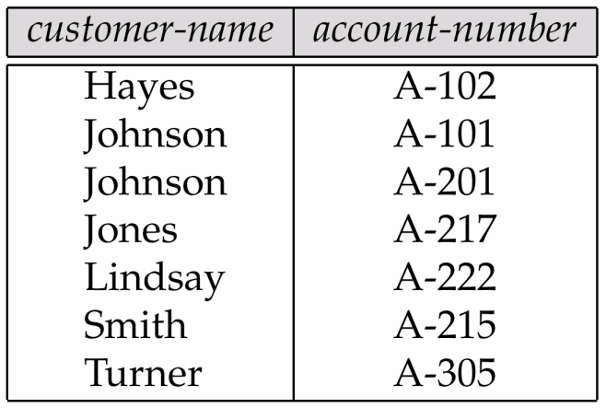
Insertion: Examples
Insert information in the database specifying that Smith has $1200 in account A-973 at the Perryridge branch.
account ← account ∪ {(“Perryridge”, A-973, 1200)}
depositor ← depositor ∪ {(“Smith”, A-973)}
Depositor
Account

Slide 22
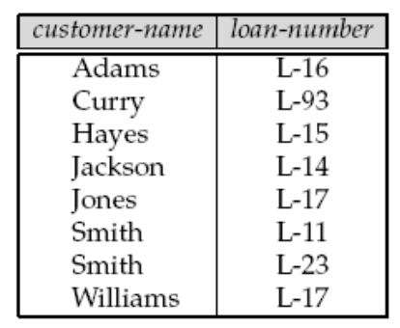
Views
In some cases, it is not desirable for all users to see the entire logical model (i.e., all the actual relations stored in the database.)
Consider a person who needs to know a customer’s name and loan branch but has no need to see the loan amount. This person should see a relation described, in the relational algebra, by
∏_{customer-name, branch-name} (borrower loan)
Any relation that is not of the conceptual model but is made visible to a user as a “virtual relation” is called a view.

Slide 23
Views
A view is defined using the create view statement which has the form
create view v as <query expression>
where <query expression> is any legal relational algebra query expression. The view name is represented by v.
Once a view is defined, the view name can be used to refer to the virtual relation that the view generates.
View definition is not the same as creating a new relation by evaluating the query expression
  Rather, a view definition causes the saving of an expression; the expression is substituted into queries using the view.

Slide 24
Views: Examples
Consider the view (named all-customer) consisting of branches and their customers.
create view all-customer as
∏_{branch-name, customer-name} (depositor account)
∪ ∏_{branch-name, customer-name} (borrower loan)
We can find all customers of the Perryridge branch by writing:
∏_{branch-name}
(σ_{branch-name = “Perryridge”} (all-customer))

Slide 25
Updates through Views
Database modifications expressed as views must be translated to modifications of the actual relations in the database.
Consider the person who needs to see all loan data in the loan relation except amount. The view given to the person, branch-loan, is defined as:
create view branch-loan as
∏ _{loan-number, branch-name} (loan)
Since we allow a view name to appear wherever a relation name is allowed, the person may write:
branch-loan ← branch-loan ∪ {(L-37, “Perryridge”)}
Problem!!!

Slide 26
Updates through Views
The previous insertion must be represented by an insertion into the actual relation loan from which the view branch-loan is constructed.
An insertion into loan requires a value for amount. The insertion can be dealt with by either.
  Rejecting the insertion and returning an error message to the user.
  Inserting a tuple (“L-37”, “Perryridge”, null) into the loan relation

Slide 27
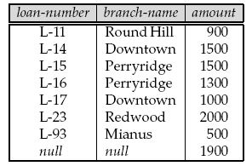
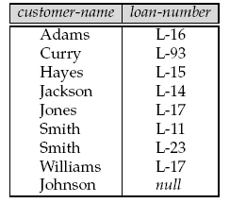
Updates through Views
Loan
Borrower
Consider
create view loan-info as
∏_{customer-name, amount} (borrower loan)
If the following insertion is performed:
loan-info ← loan-info ∪ {(“Johnson”, 1900)}
Loan
Borrower
Modifications are NOT permitted on Views

Slide 28
References
Chapter 3, Database System Concepts, Silberschatz, Korth, Sudarshan

